Slide 1





RedHat
About Me :
Name : Kautilya Kankipati
College : Ramachandra College of Engineering Eluru
Github : https://github.com/kautilya2000/
Idea : School Database
Prepared for : Ratnam Schools Nellore
PHOTO You Liked the Most :)

Slide 2

🙂Project scope🙂
RedHat
To know what’s the position of a particular student in the parent point of view.
To know what’s the position of a particular student in the faculty point of view.
To view the student result of the previous year’s also.

Slide 3






👦🏻Customer Challenges👍🏻
RedHat
Student information management
Staff information management
Attendance information management
Time table management
Exam schedule management
Event management
Student results management

Slide 4




⚠Modules🔰
RedHat
Home
About School/Institution
Login

Slide 5





Module Description
RedHat
Home Page
In this home page we will be displaying the recent activities of the school or institution and club activities,sports,contests,student news,college news,student corner & institution features.

Slide 6




Module Description
RedHat
Cont.
About Page
In this about page we will be showing the details of the institution when the institution has been established, courses offered, complete contact and the location details of the institution, activities, fee structure depending upon the class or the course chosen.

Slide 7



Module Description
RedHat
Cont.
Login Page
In this login page depending upon the credentials given by the user the page will be being displayed this is of one type login based system it contains the data of student & faculty information and the students attendance and the results are being displayed in the page of the respective student or the faculty portal
Login
Admin
Student/Parent
Faculty

Slide 8





Module Description
RedHat
Cont.
Admin Login
It allows the admin to see the entire institution criteria.
The admin have the right to create a new class and subject.
The admin has the only right to the post the student results.

Slide 9



Module Description
RedHat
Cont.
Faculty Login
It allows the faculty to see the criteria regarding his subjects.
The faculty also can see the cumulative attendance of the particular class or the course.
The faculty also can see the particular student attendance or the marks in the particular subject or the entire year which the student will be studying.

Slide 10

Module Description
RedHat
Cont.
Student Login & Parent login
In this page the student can only see his or her performance only but not possible to see the other student’s performance unless and until he knows the credentials of the other student.
In this page the parent can see the performance of the son or daughter by entering the credentials given by the institution.

Slide 11


🔎Programming Languages Used💻
RedHat
Html
Css
Bootstrap
Java
Script
Php
My
Sql

Slide 12



💭Languages Description🗯
RedHat
➡Html: It ensures the proper formatting of text and images so that your internet browser may display them as they are intended to look. Without HTML, a browser would not know how to display text as elements or load images or other elements.
➡Css: It is the language for describing the presentation of Web pages, including colors, layout, and fonts. It allows one to adapt the presentation to different types of devices, such as large screens, small screens, or printers.

Slide 13



💭Languages Description🗯
RedHat
➡Bootstrap: It is a framework to help you design websites faster and easier. It includes HTML and CSS based design templates for typography, forms, buttons, tables, navigation, modals, image carousels, etc.
➡Php: it is a server-side scripting language that is used to create dynamic web pages that can interact with databases. It is a widely-used open source language that is specifically used for web application development and can be embedded within HTML.

Slide 14


💭Languages Description🗯
RedHat
➡Mysql: It is a relational database management system based on SQL – Structured Query Language. ... The most common use of MySQL however, is for the purpose of a web database. It can be used to store anything from a single record of information to an entire inventory of available products for an online store.

Slide 15


💻Software Requirements🖥
RedHat
Visual studio/notepad++/brackets/
sublime text (Text Editors)
Xampp (Local Server)
Figma (to resize the images)
Adobe Xd (to design the wireframes)

Slide 16
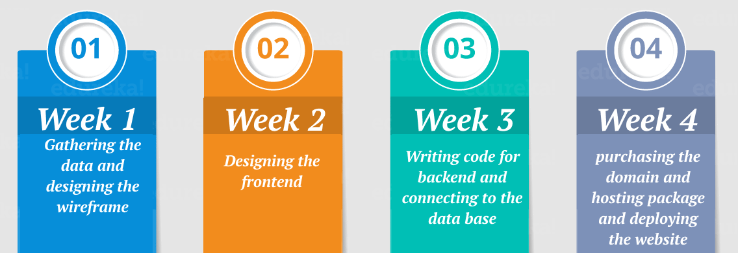
🗓Estimated Time to Complete the Website🕔
RedHat

Slide 17
RedHat
Thank You

